Slide 1
SHWN_GFHD (GOFORTH EXPRESS)
Always key the following, visible in the invoice separator sheet:
Batch ID (68) BAT ID (69) Value/No
Client Code (68) CL CODE (69) SHWN
Scac Code (68) SCAC CODE (69) GFHD

Slide 2
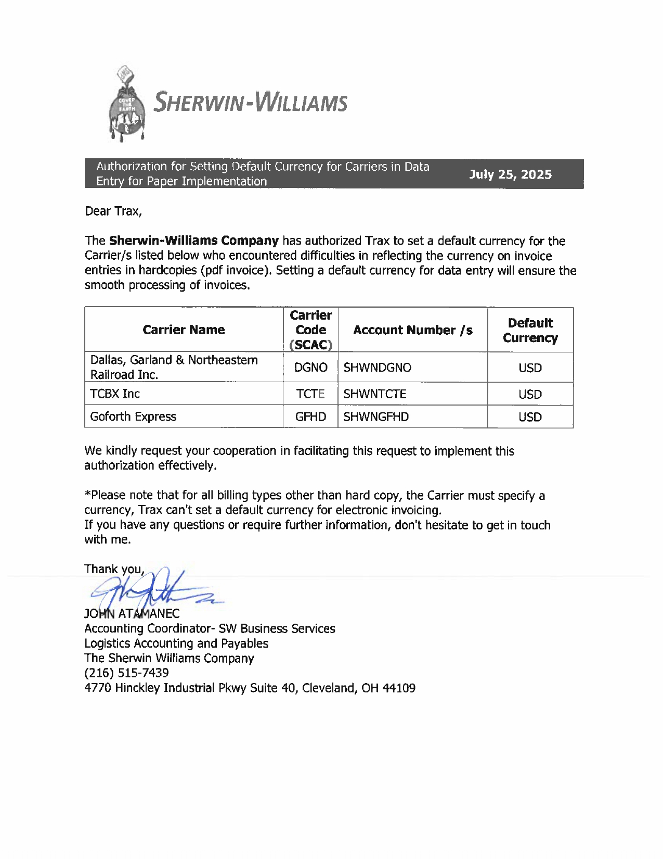
09 CURR
09

Slide 3
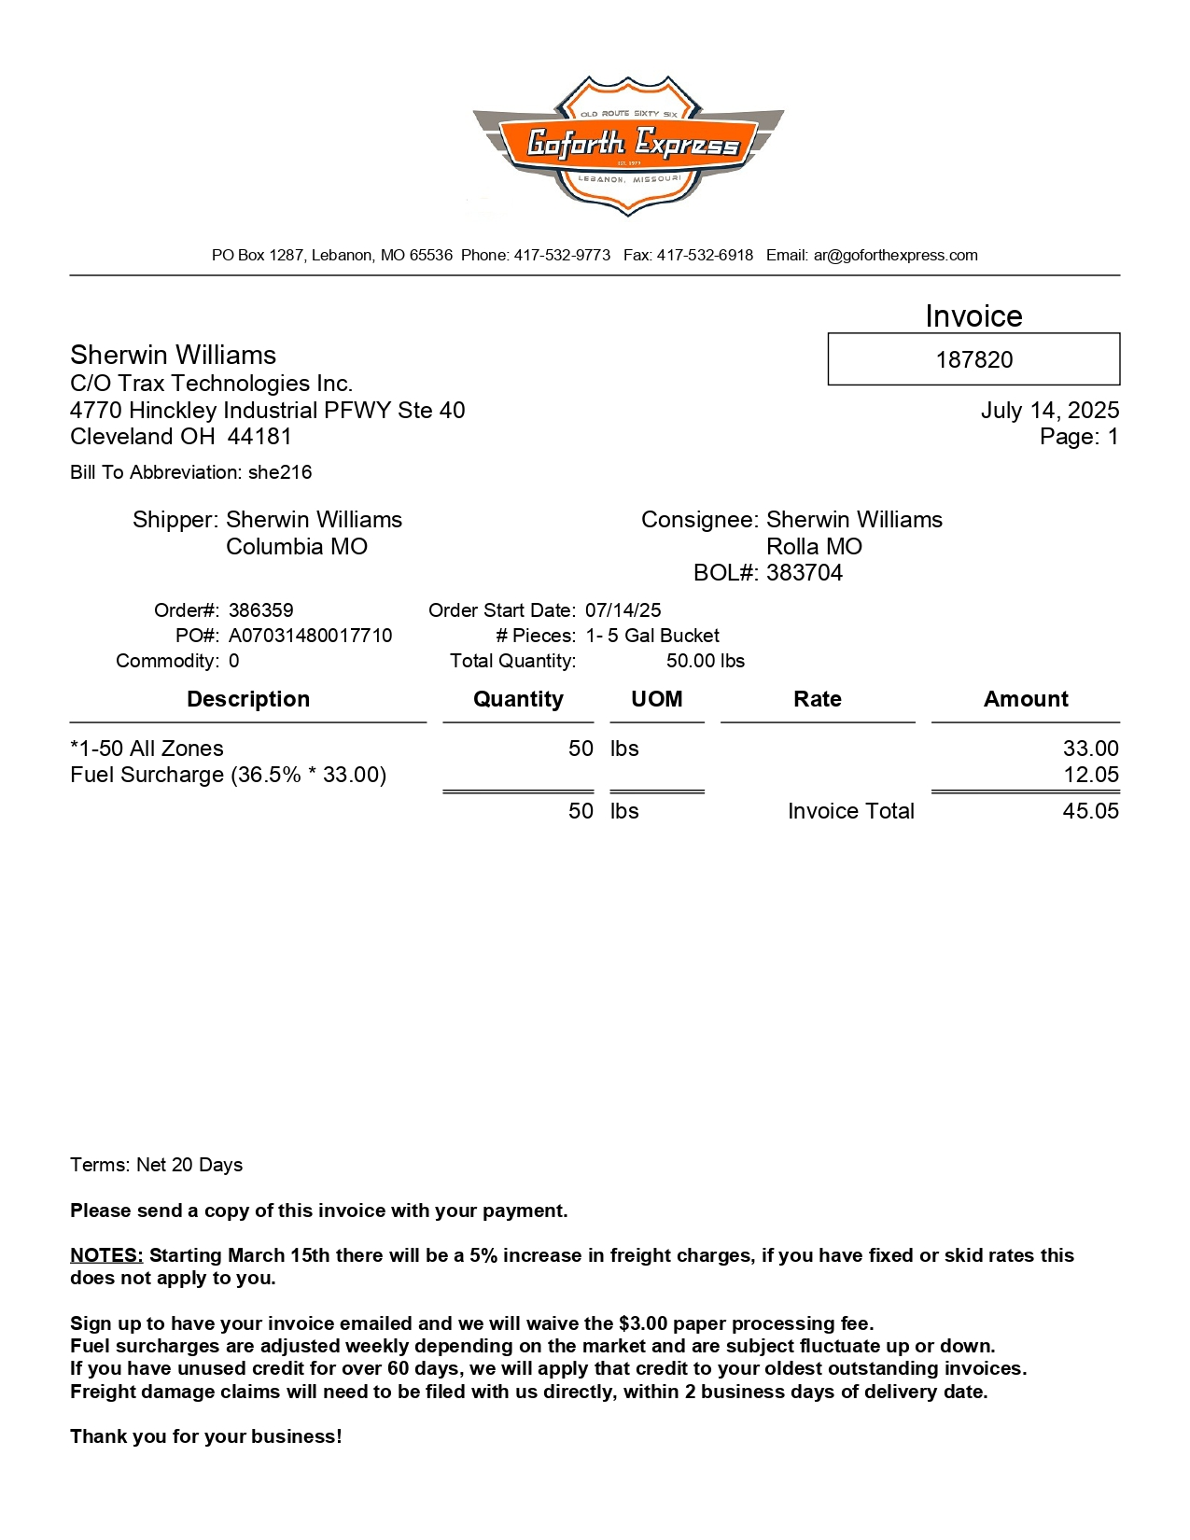
01
03
68a BOL
68b ORDER_NO
68c PO
01 REMIT TO
02 BILL TO
03 INV KEY
10 DATE
27 SHIPPER INV
30 CONSIGNEE INV
46 PIECES
47 PIECES TYPE
61 PICK UP
72 LINE ITEM DESC
74 LINE ITEM QTY
85 LINE ITEM AMT
08/14 INV AMT/ FB AMT
75 RATE
42/43 ACTL/FNCL WT
44/45 WT UOM
02
10
27
61
30
47
68b
68c
46
68a
72
85
75
74
08/14
42/43
44/45

Slide 4
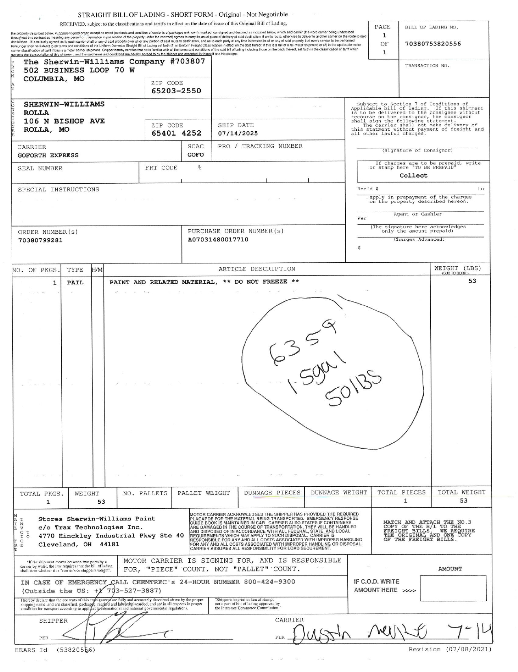
68a
28
31
61
68a BOL
68b ORDER_NO
28 SHIPPER BOL
31 CONSIGNEE BOL
61 SHIP DATE
90 PROD DESC
95 PCS CNT
96/97 GROSS WT/ NET WT
98 WT UOM
68c PO
68c
68b
90
98
95
96/97

Slide 5
6
For Verification Table
 | NAME | DATE
DI-72434 | CIDJANE J. LOCAYLOCAY | 07/24/2025

